Slide 1
Image recognition using CNN on CIFAR-10 Dataset
- Navneet Pratap

Slide 2
Methods used and prediction of the model
Methods used:
Convulution layers
Pooling layers
Fully connected layers
Prediction of the model:
Accuracy of image recognition from the given Dataset of CIFAR-10

Slide 3
Accuracy and operation cost
Accuracy:
68.31 %
Operation cost:
All applications used were google-based(Google Collab Research)

Slide 4
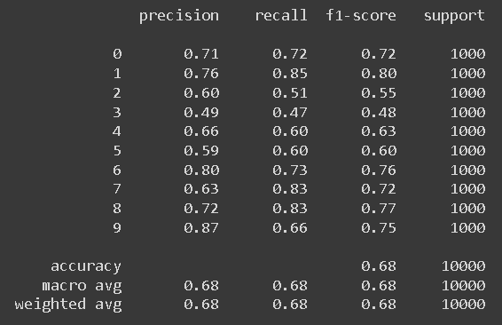
Precision

Slide 5
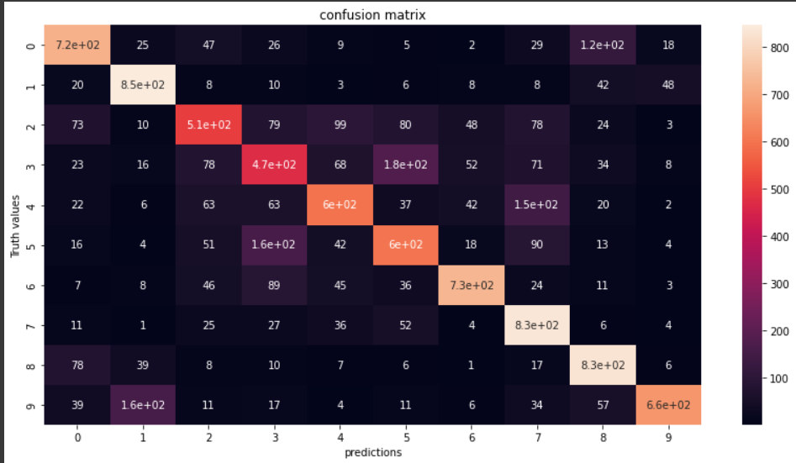
Confusion Matrix

Slide 6
Thank You !

